Slide 1
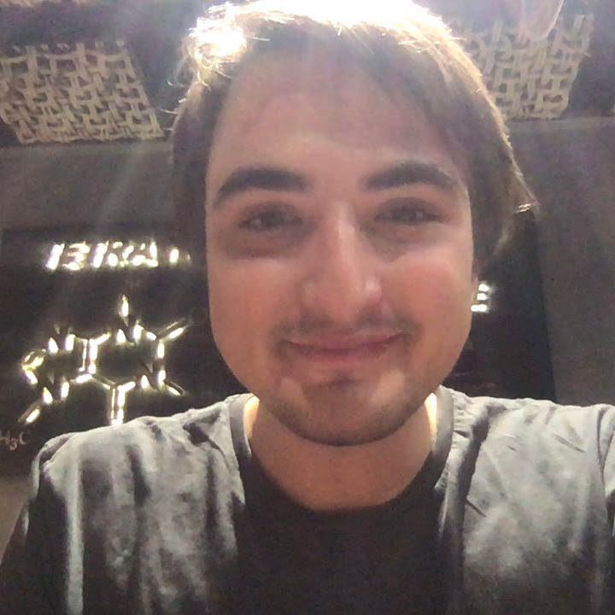




Pitch ProMe by JMOSS
Ozan Marco Xuecong Farouk Sairaghav
Incesulu Fasanella Liu Jeffar Venkataraman

Slide 2
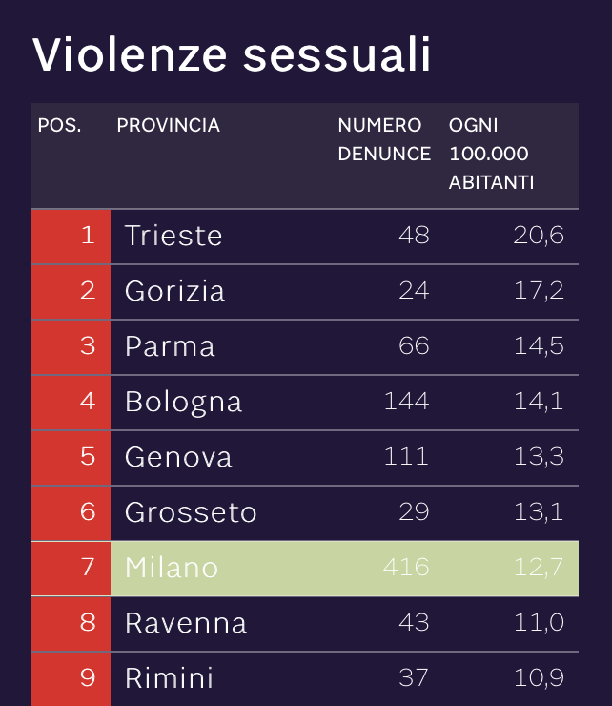
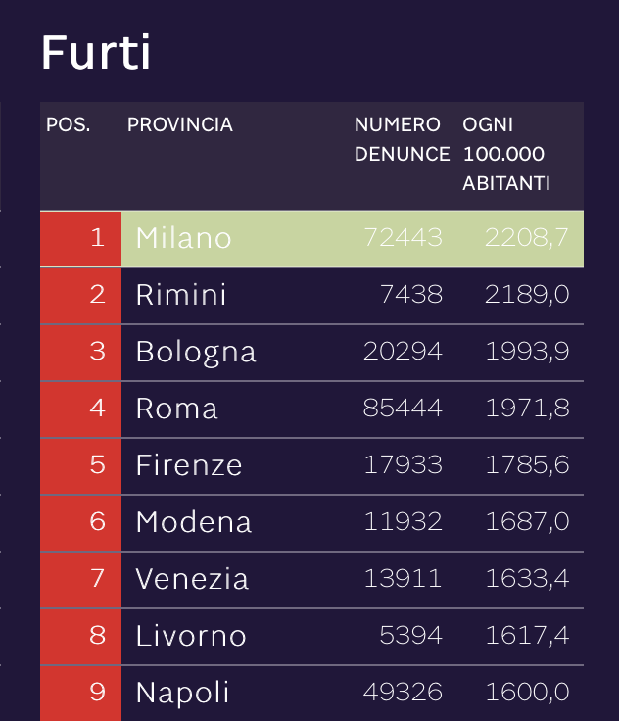
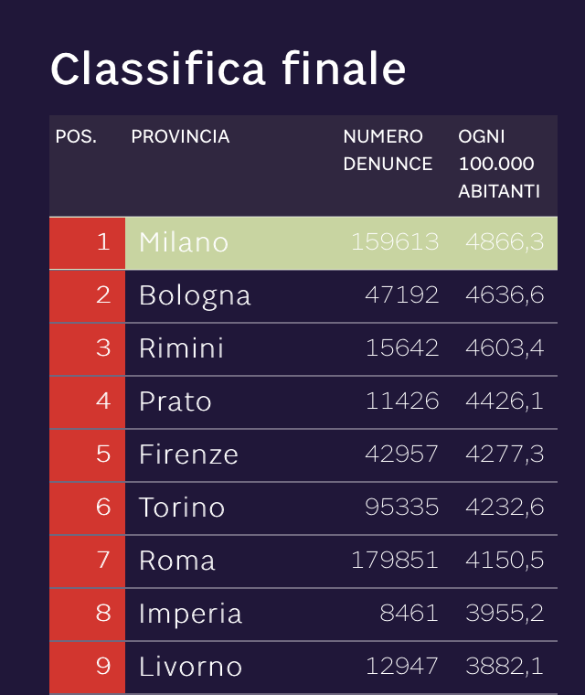
The Problem
Lack of structure street-level route safety information
Lack of transparency on the latest crime activities in Milan
Credits: ilsole24ore.com

Slide 3
Solution/Value Proposition
An App that allows you to:
Look for streets or zones safety
Find the safest way home
Report crimes and help the community
Market Potential (source: Istat.it):
10 million travelers visited Milan in 2019
20k international students in Milan in 2021
3m people applied for residency permit
325k Italians moved from one region to another

Slide 4
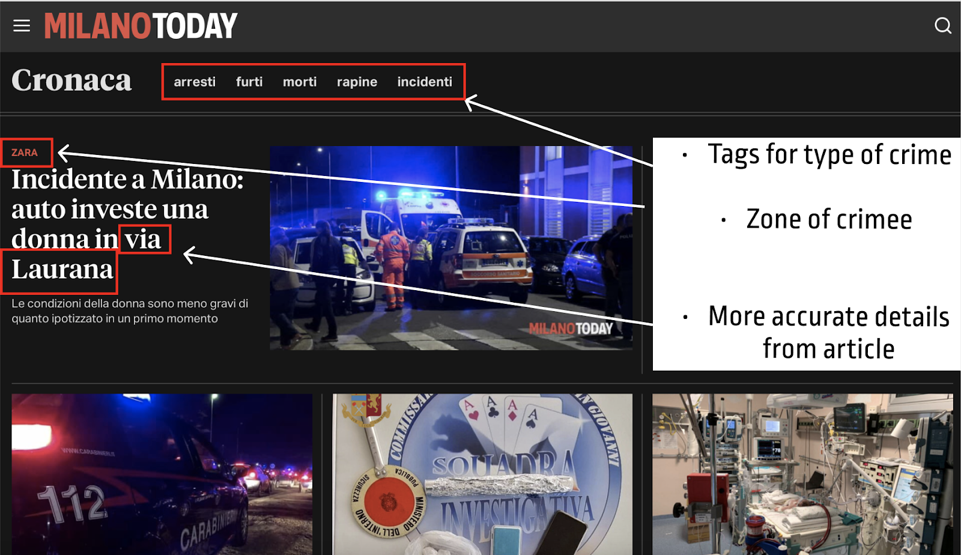
Raw Data from News
User Reports

Slide 5
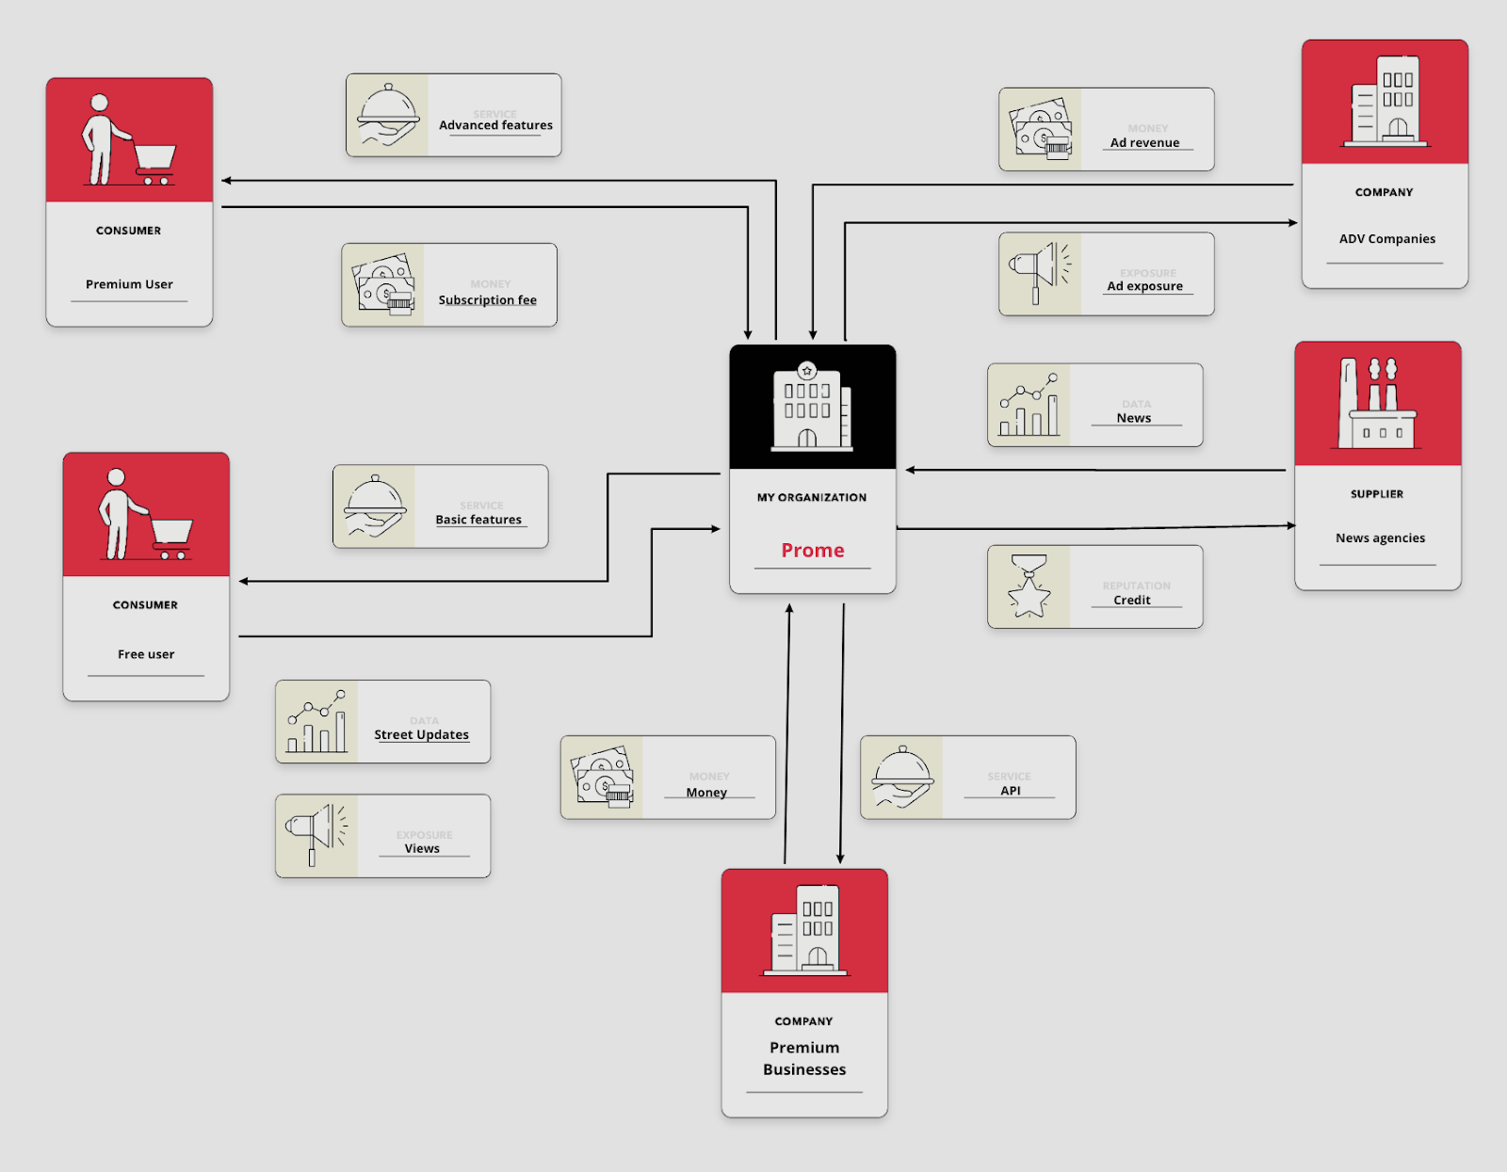
Business Model
Cost Structures:
Marketing
Service hosting
HR
Revenue:
Subscription fee
Ads (free version)
Future Revenue: API

Slide 6

Competition Analysis
Google Maps.
Route planning. No safety consideration. Inaccurate crowdedness.
Social media.
Instant posts about new issues. Unstructured data. Bias.
City guides & real estate analysis.
Overall information. No real-time details.
Police notices & Emergency reporting apps.
Authentic data. Limited access to the public.
!

Slide 7
Proof of Concept ProMe by JMOSS
Ozan Marco Xuecong Farouk Sairaghav
Incesulu Fasanella Liu Jeffar Venkataraman

Slide 8
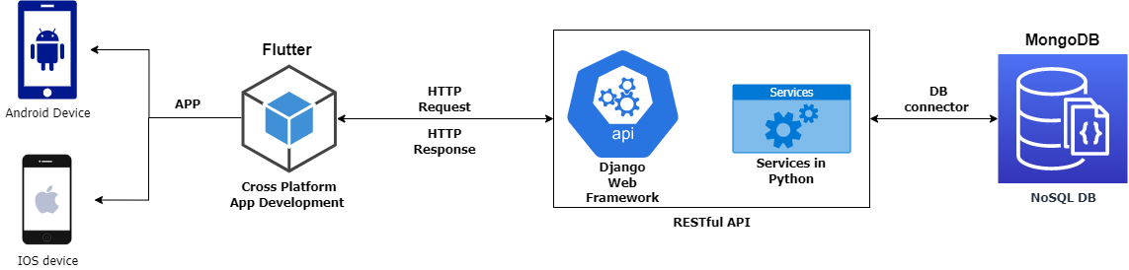
Architecture Refresh

Slide 9
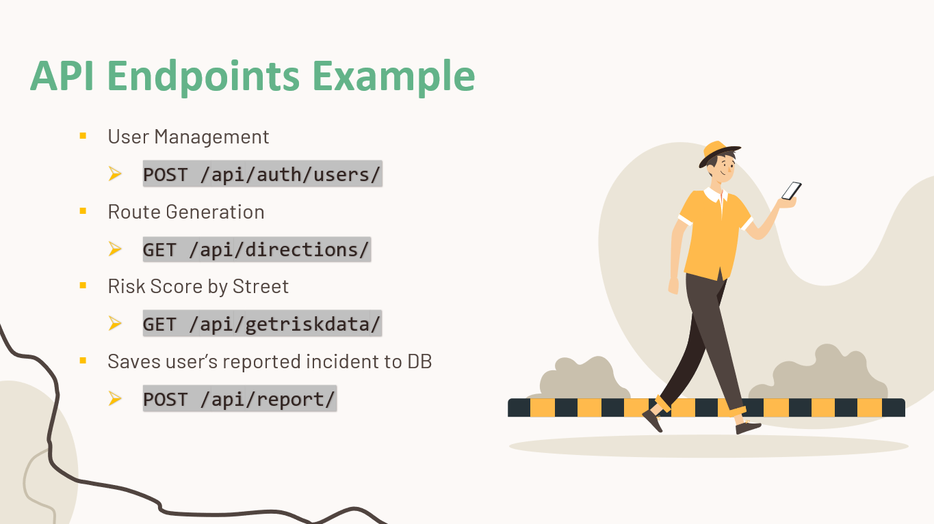
Features Implemented
API
Mobile App
Safety Score of Route
Safety Score History by Street
Most Common Crimes
Criminality Trends
Report Ongoing incidents

Slide 10
API Endpoints Example
User Management
POST /api/auth/users/
Route Generation
GET /api/directions/
Risk Score by Street
GET /api/getriskdata/
Saves user’s reported incident to DB
POST /api/report/

Slide 11
How is it Implemented?
Routing Service Provider – Mapquest.com
News Source Provider - Milanotoday.it
Risk Assessment
Unsafe
Moderately Unsafe
Safe
!

Slide 12
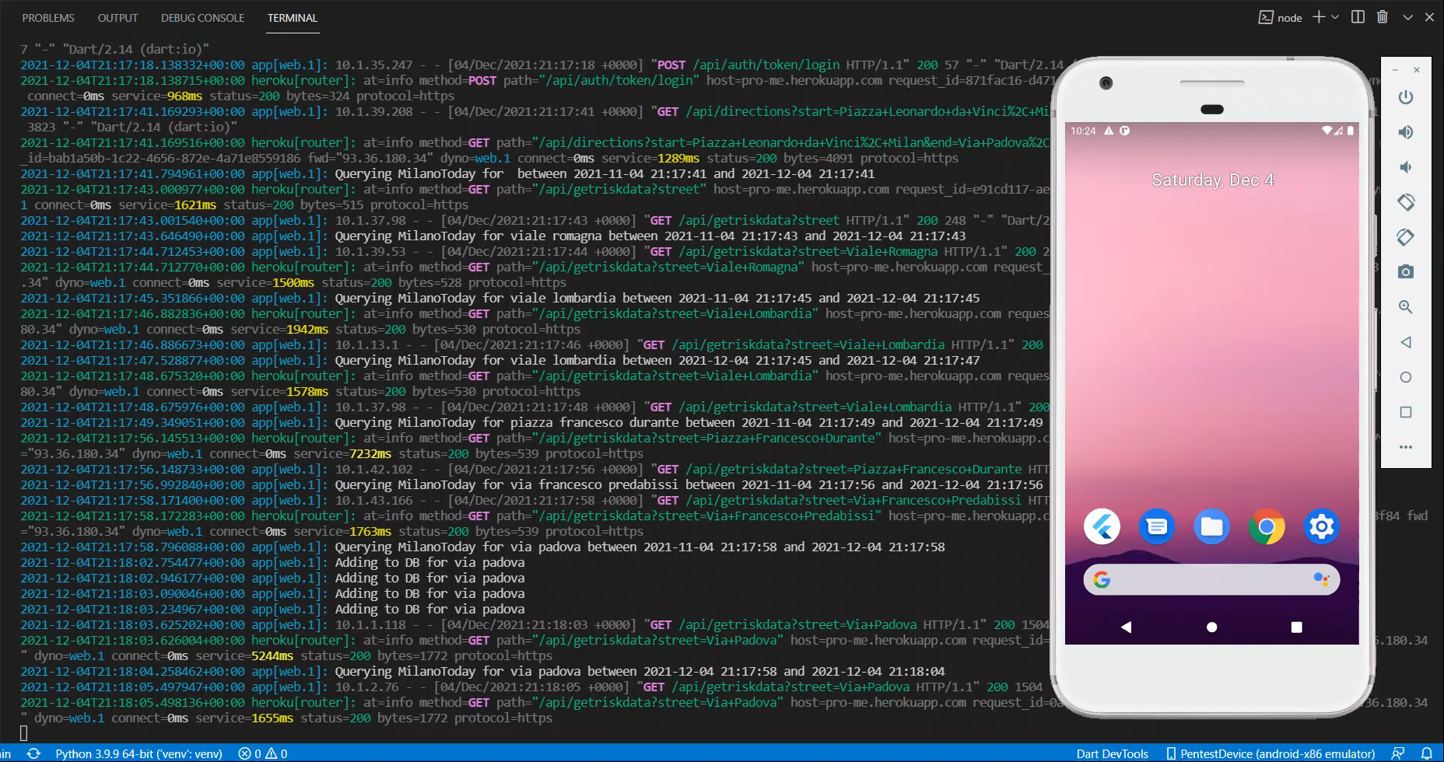
Demo

Slide 13
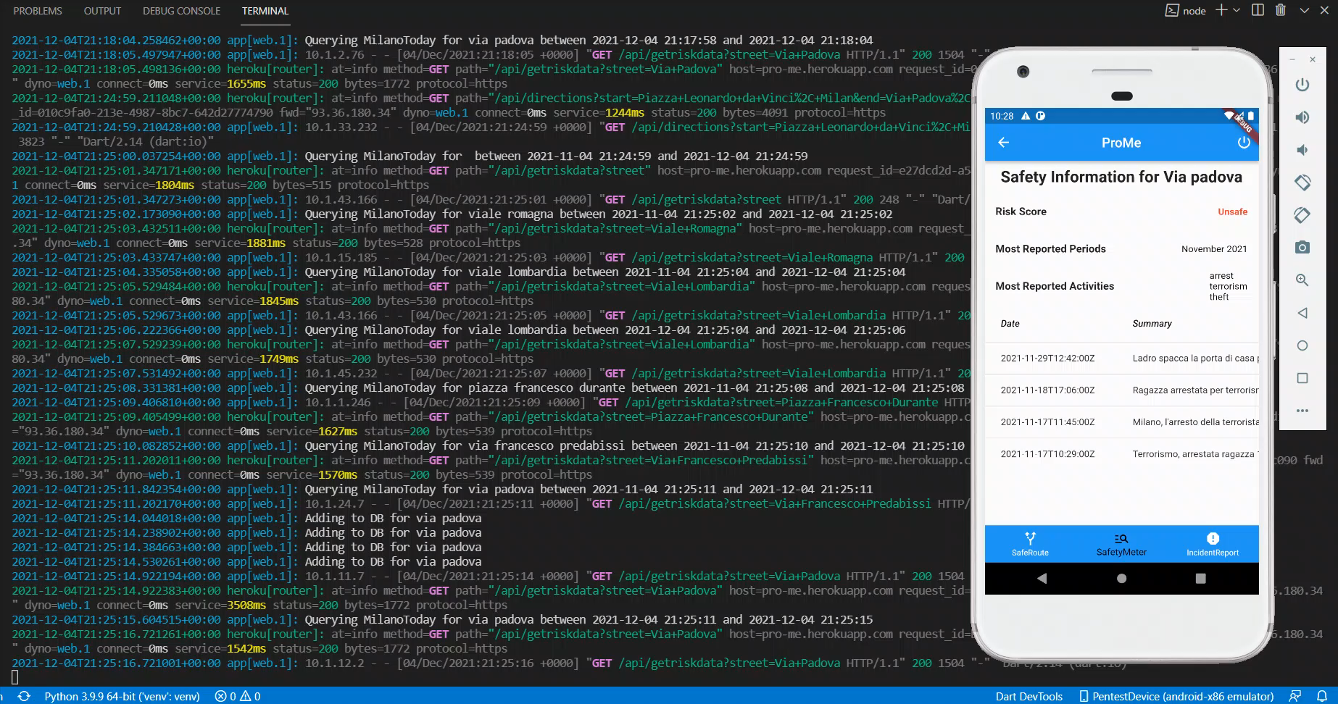
Demo

Slide 14
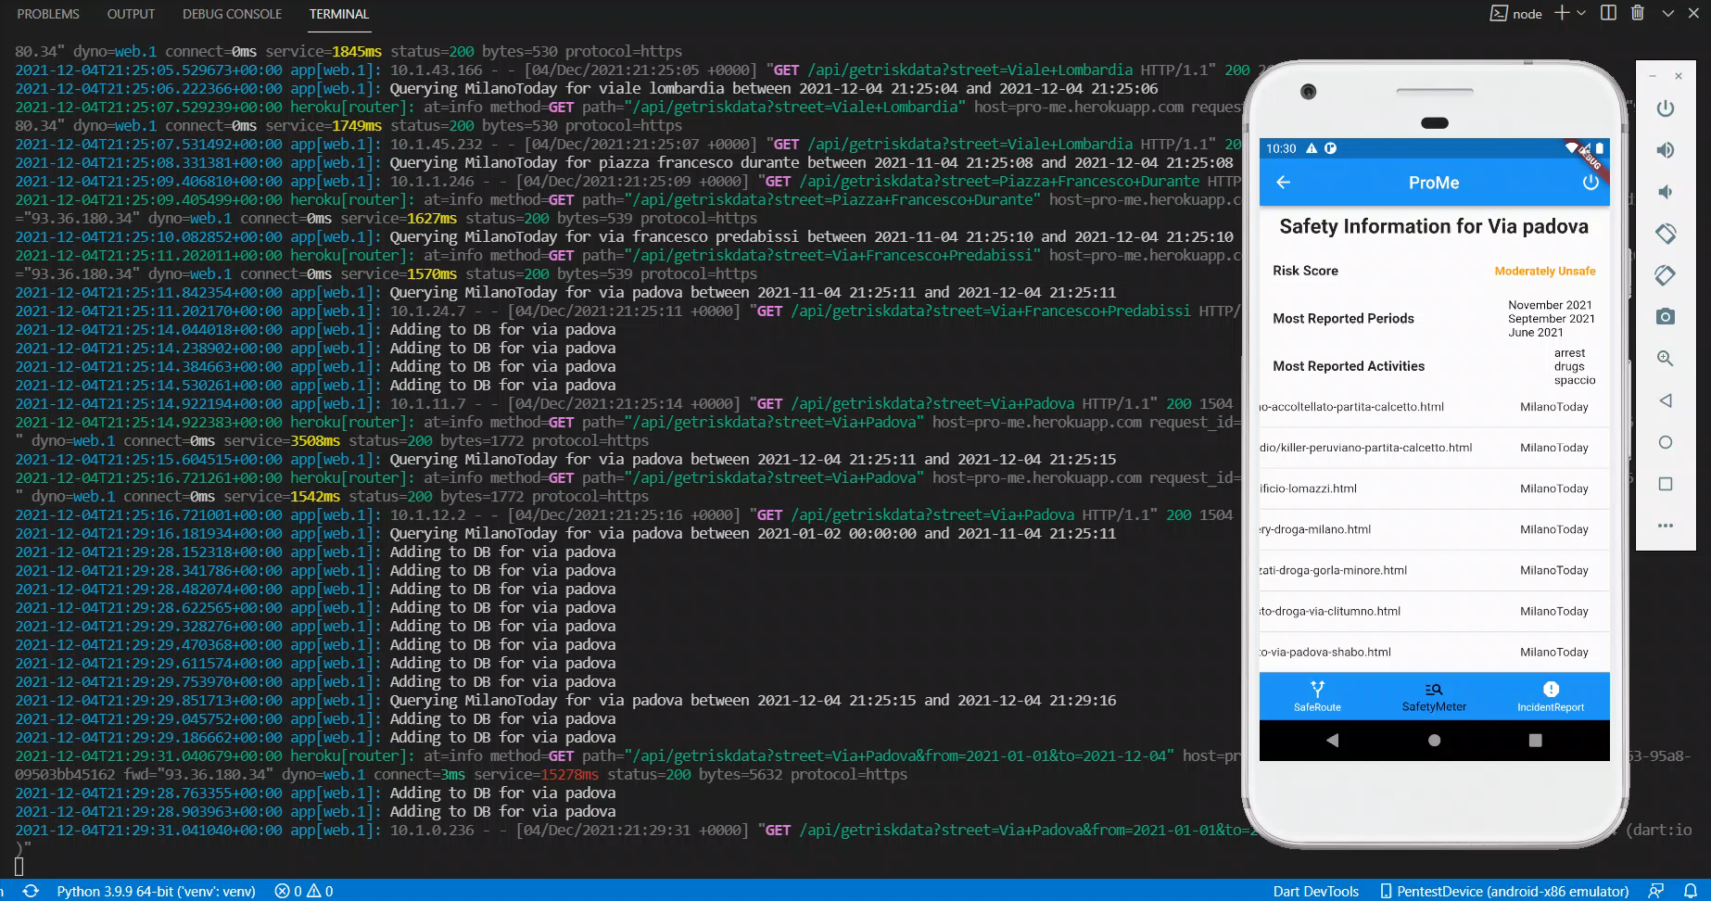
Demo

Slide 15
Thank You !

